Slide 1
FAQ
San Donato Milanese

Slide 2
AGENDA
TRANSVERSAL QUESTIONS
EXECUTION FEEDBACK
WHERE DO I SEE THE MANDATORY EXECUTION FB THAT I MUST FILL IN? (slide 7)
WHEN SHOULD THE EXECUTION FB BE COMPILED?(slide 8)
WHAT IS THE PROCESS OF COLLECTING EXECUTION FEEDBACK?(slide 9)
WHAT ARE THE REGULATORY REFERENCES FOR THE EXECUTION FBs? (slide 10)
WHO ARE THE ACTORS INVOLVED IN THE EXECUTION FB COMPILATION? (slide 11)
WHAT HAPPENS IN CASE THERE IS A VERY NEGATIVE EXECUTION FB/RECURRING NEGATIVE FB?(slide 12)
WHAT HAPPENS IN THE EVENT OF REPORTING CRITICAL ISSUES DURING THE EXECUTION OF THE CONTRACT?(slide 13)
HOW TO CREATE AN OPTIONAL PERFORMANCE FEEDBACK? (slide 14)
HOW TO ADD A CONTRACT IN VMS ?(slide 15-16)
WHEN IS FEEDBACK MANDATORY? (slide 3)
WHERE DO I FIND THE LIST OF RELEVANT COMMODITY CLASSES? (slide 4)
ON THE BASIS OF WHICH CRITERIA ARE THE RELEVANT CCs IDENTIFIED? HOW OFTEN ARE THEY REVIEWED?(slide 5)
WHAT IS THE FEEDBACK QUESTIONNAIRE CURRENTLY IN USE? (slide 6)
WHO AND WHEN CAN NOTIFY THE PERFORMANCE TO THE SUPPLIER? IS REQUIRED?(slide 23)
CAN I CHANGE MY ANSWERS TO AN EXECUTION FB/ TENDER FB? (slide 24)
WHAT SHOULD I DO IF I NEED TO CHANGE AN ALREADY APPROVED FB? (slide 25)
HOW CAN I REQUEST THE ACCESS TO VMS? (slide 26)
WHAT IS THE DIFFERENCE BETWEEN AN EXECUTION FB AND AN EVIDENCE?(slide 27)
HOW AND WHEN TO OPEN EVIDENCE FOR A SEVERE MISPERFORMANCE? (slide 28-29)
WHO CAN GIVE ME SUPPORT IN THE EVENT OF PROBLEMS RELATED TO VMS FUNCTIONING? (slide 30)
TENDER FEEDBACK
WHERE DO I SEE THE MANDATORY TENDER FB THAT I MUST FILL IN? (slide 17)
WHEN SHOULD THE TENDER FB BE FILLED IN?(slide 18)
WHAT IS THE TENDER FEEDBACK COLLECTION PROCESS?(slide 19)
WHO ARE THE ACTORS INVOLVED IN THE TENDER FB COMPILATION (slide 20)
WHAT HAPPENS IN THE EVENT OF NEGATIVE TENDER FB OR REPORTS ABOUT PARTICIPANTS IN THE PROCEDURE? (slide 21)
HOW TO CREATE AN OPTIONAL TENDER FEEDBACK? (slide 22)

Slide 3
WHEN IS FEEDBACK MANDATORY?
Feedback is mandatory if BOTH of the following conditions are met:
1. The contract is inherent in one of the 79 CCs relevant to the feedbacks;
2. The Administrative Value of the contract is:
- >EUR 450k for "open" contracts;
- >EUR 150k for "closed" contracts.
The list of CCs and the thresholds associated with the contracts to be submitted to feedback are periodically reviewed, also on the basis of developments in the CCs master data, and appropriately communicated to the units concerned through publication on the information system.
The VEMAD unit periodically verifies if the mandatory FBs have been filled in on suppliers qualified by Head Quarter, on international suppliers and on mega-suppliers.

Slide 4
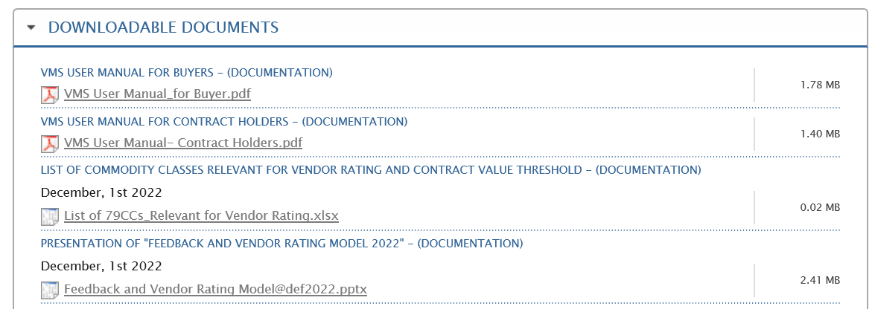
WHERE DO I FIND THE LIST OF RELEVANT COMMODITY CLASSES?
The portal (Procurement Community) is an area containing regulations, tools and information useful to Eni's Procurement Units
Refer to the version on the portal to be sure you have the most up-to-date one
List of 79 compulsory CCs, last update 01/12/2023

Slide 5
ON THE BASIS OF WHICH CRITERIA ARE THE RELEVANT CCs IDENTIFIED? HOW OFTEN ARE THEY REVIEWED?
EVALUATION CRITERIA
CRITICAL ISSUES
RELEVANCE
SYNERGY
DRIVER
BUSINESS
HSE
HUMAN RIGHTS
CYBER
TOTAL CONTRACT VALUE
N. OF CONTRACTS
INCIDENCE ON OVERALL CONTRACT VALUE ITALY
STRATEGIC CCs
CCs RMI
The list of relevant GMs is reviewed annually by the VEMAD Team, which can confirm or modify it

Slide 6
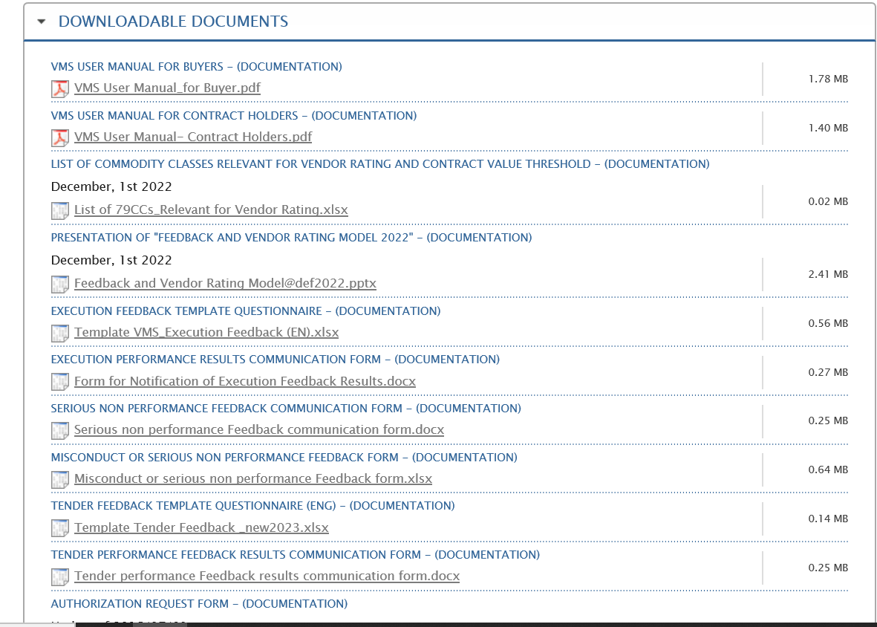
WHAT IS THE FEEDBACK QUESTIONNAIRE CURRENTLY IN USE
Template Execution Feedback
Template Tender Feedback
Refer to the version on the portal to be sure you have the most up-to-date one
In the «Feedback tools» section of E-procurement it is possible to download the questionnaire currently in use (both Execution and Tender FB)

Slide 7
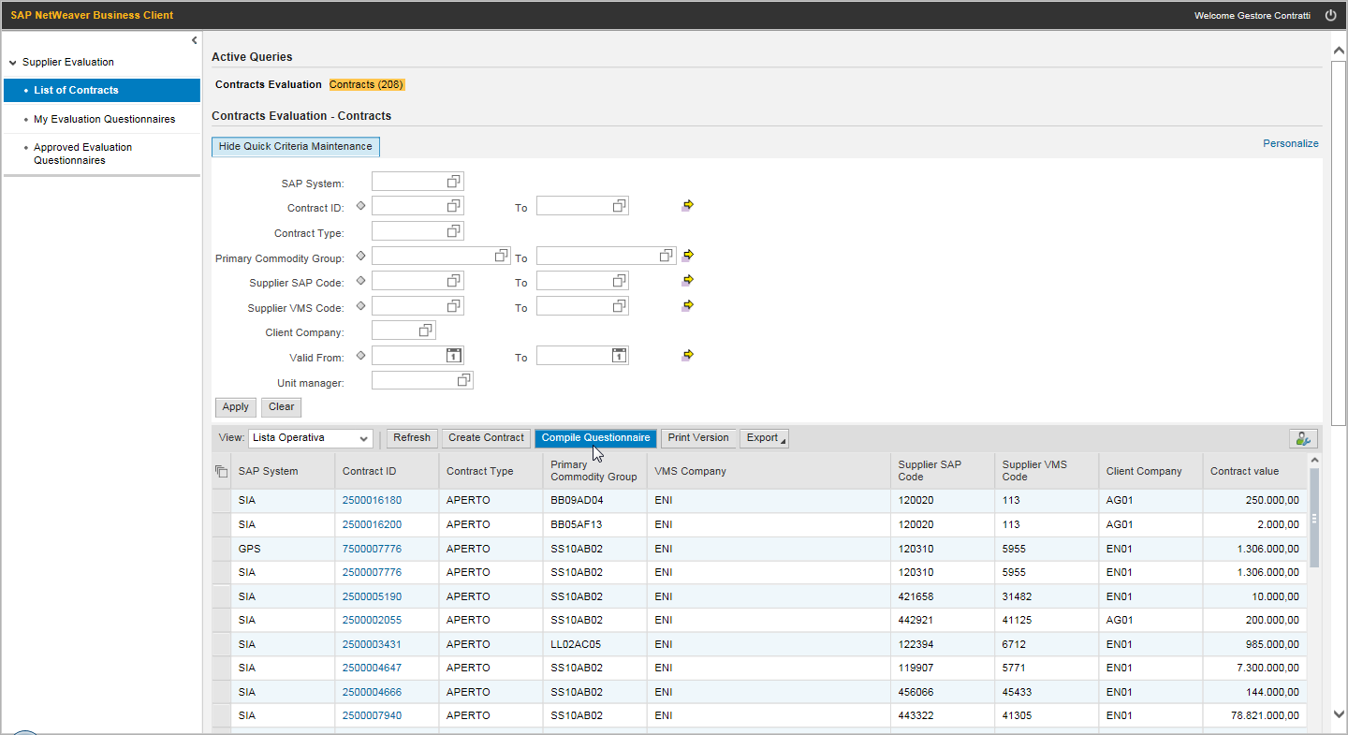
WHERE DO I SEE THE MANDATORY EXECUTION FB THAT I MUST FILL IN
Each Contract Holder has access to the list of Contracts under management. The list of contracts allows to start compiling the feedback manually enter a contract in VMS in addition to those inherited from SIA and GPS.
List of Contracts

Slide 8
WHEN SHOULD THE EXECUTION FB BE COMPILED
The execution feedback is recorded at least once per year, starting from the initial date of the contract, and at the end of the contract.
Eg: a contract is valid from 01.01.2022 – the feedback must be filled in January 2023;
A non-mandatory feedback can be filled in at any time;
In some cases (e.g. negative performances), the manager may be asked to collect feedback more frequently (e.g. against decisions by the Evaluation Team).
N.B. In the case of open contracts, the annual deadline is valid only if during the year in which the contract was used/work orders and/or delivery orders were issued. Since for mandatory FBs the VMS system automatically creates the FB, in case of non-use of the contract, please report the case to mbx vendor development

Slide 9
WHAT IS THE PROCESS OF COLLECTING EXECUTION FEEDBACK?
VMS system
Compiler
Contract Holder
In correspondence with the annual recurrences of the contract validity start date, VMS sends an email to the compiler to request the compilation of the execution feedback.
Deadline = 30 days from the email receival
1
The compiler, which monitors the performance of the supplier, fills out the execution feedback form in VMS
4
The Contract Holder approves the feedback and manages the notification to the supplier
2
3
Site HSE Ref.
5
Monitors and evaluates the supplier on HSE aspects and fills in the HSE section of the feedback
5
7
6
VEMAD-A
7
Quarterly analysis of feedback with sub-threshold score and possible management in the Evaluation Team of poor performance/non-compliance

Slide 10
WHAT ARE THE REGULATORY REFERENCES FOR THE EXECUTION FBs?
Cerca immagine in en
The feedback process is based on key criteria for evaluating the supplier's performance and is aimed at:
collecting information on the behavior of the supplier in the execution phase of the contract;
measuring the level of performance provided by the supplier also in terms of compliance with HSE requirements;
acquirinf information on the behavior of all the subjects who, on behalf of the supplier, have operated within the scope of the contract;
The Contract Holder takes care of the feedback compilation activities, approves it and manages the notification to the supplier in the cases provided for by the legislation.
Source: Management of post-award contracts - pro pr 001 eni spa r04

Slide 11
WHO ARE THE ACTORS INVOLVED IN THE EXECUTION FB COMPILATION?
Procedure: Management of post-award contracts - pro pr 001 eni spa r04
Procedure: Supplier Performance Assessment and Vendor Rating - pro pr 011 eni spa r03
Receiving unit: business unit that receives the goods or works/services. It is the responsibility of the receiving unit: to carry out the technical-operational check of the goods received, the materials used and the services/works received.
User unit prepares supplier performance evaluation feedback.
Contract Holder unit takes care of receiving notifications from user units regarding any anomalies detected during the execution of the contract, also for the purpose of issuing feedback.
HSE Representative monitors and evaluates the supplier on HSE aspects and fills in the questions in the HSE section of the execution feedback form (*), detects and reports to the contract holder any serious breaches detected in the HSE area.
The figure of execution feedback compiler is identified by the contract holder: it may coincide with the user unit. The contract holder takes care of the correct performance of the feedback compilation activities, approves it and manages the notification to the supplier.
(*) In the case of commodity classes with high or significant HSE criticality (A or B)

Slide 12
WHAT HAPPENS IN CASE THERE IS A VERY NEGATIVE EXECUTION FB/RECURRING NEGATIVE FB?
VERY NEGATIVE EXECUTION FB (IP<30/100)
In case of detection of a very negative execution fb or in case of criticality signaled, VEMAD analyzes the answers and can ask for further information and/or request the compilation of other feedbacks to understand if it is a widespread behavior of the supplier;
It is recommended to indicate as much information as possible in the notes field to make the analysis easier.
RECURRING NEGATIVE EXECUTION FB
In case of detection of 3< fb of very negative execution on the same supplier, VEMAD analyzes the answers and can ask for further information and/or meetings with the contract holder/s, with whom to evaluate the need to open an evidence.

Slide 13
WHAT HAPPENS IN THE EVENT OF REPORTING CRITICAL ISSUES DURING THE EXECUTION OF THE CONTRACT?
If a criticality is detected, it must be reported when compiling the execution feedback.
Any CRITICALITIES reported have no impact on the score.
The types of CRITICALITIES reported are exemplary and not exhaustive.
Regarding the reporting of feedback from serious breaches, please refer to the Procedure "Assessment of performance of suppliers and Vendor Rating" - pro pr 011 eni spa r03.
The Vendor Development team monitors the critical issues reported on a monthly basis and initiates the necessary actions.

Slide 14
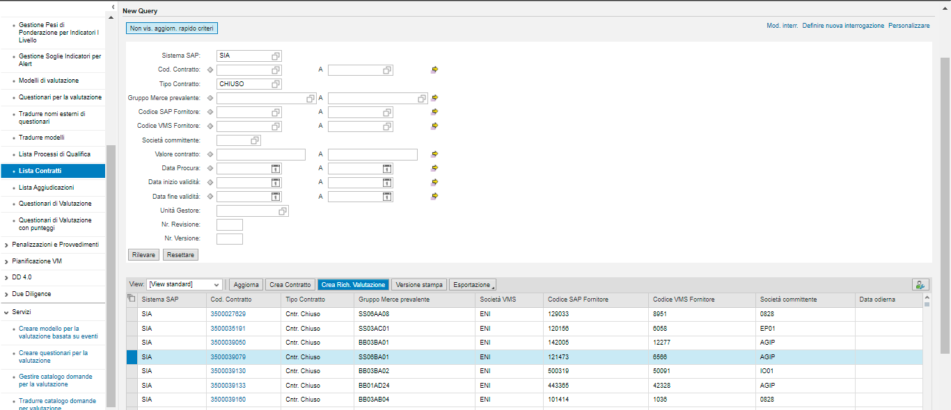
HOW TO CREATE AN OPTIONAL PERFORMANCE FEEDBACK
Operating Instructions
Create the Request of fb form
For a specific CONTRACT it is possible to register feedback on a voluntary basis, if VMS has not generated the request for completion by e-mail (not mandatory feedback)
Select the row of the contract of interest within the List of contracts
Click on “Crea Rich. Valutazione”
VMS confirms the creation of the request by providing an identification number: this number represents the feedback number
VMS sends the email containing the link to open the Questionnaire

Slide 15
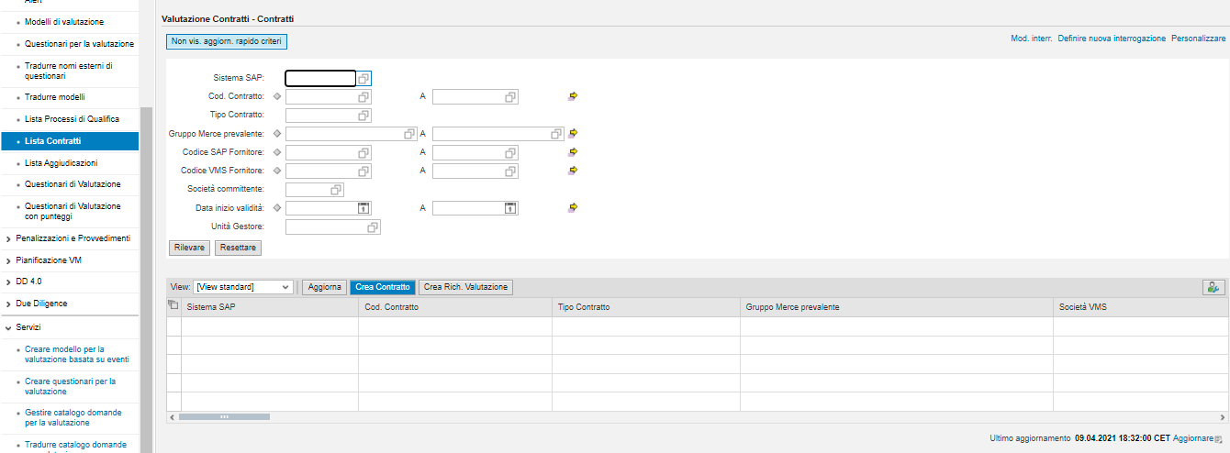
… AND IF THE CONTRACT IS ABSENT IN VMS?
Create Contract
The command allows you to manually enter a Contract in VMS in addition to the list of contracts received from the SIA and GPS systems

Slide 16
HOW TO ADD A CONTRACT IN VMS
Create Contract
Fields marked with * are mandatory
Contract (10-digit alphanumeric code)
Type of contract (Closed or Open)
Prevailing Commodity Class
Supplier SAP code (VMS code and company name will be filled in automatically)
…
Customer Company (Organizational Data)
Manager Unit (Organizational Data)
Entered the SAP, don't forget to press enter
The VMS code and Company name will appear

Slide 17
WHERE DO I SEE THE MANDATORY TENDER FB THAT I MUST FILL IN?
Each Purchasing Unit has access to the list of managed procedures.
The list of procedures (“lista aggiudicazioni”) allows you to start compiling the feedback
Lista Aggiudicazioni

Slide 18
WHEN SHOULD THE TENDER FB BE FILLED IN?
The mandatory tender feedback is detected together with the approval of the Contract Award Memorandum (PAC), on:
contracted suppliers;
all participants in tender procedures in which at least one of the suppliers has engaged in incorrect conduct, as envisaged by the questions in the tender feedback form, such as to render its performance "insufficient" or has committed serious breaches identified.
A non-mandatory feedback can be filled in at any time.

Slide 19
WHAT IS THE TENDER FEEDBACK COLLECTION PROCESS?
VMS System
Compiler
Responsible for the procedure
At the closure of the PAC, VMS sends an email to the compiler to request the compilation of the tender feedback.
Deadline = 30 days from the email receival
The compiler, the buyer who managed the procedure, fills in the tender feedback form in VMS
The RUP approves the feedback and manages the notification to the supplier
1
2

Slide 20
WHO ARE THE ACTORS INVOLVED IN THE TENDER FB COMPILATION?
Procedure: Supplier Performance Assessment and Vendor Rating - pro pr 011 eni spa r03
Feedback compiler - Resource belonging to the Procurement Unit, which manages the procedures:
monitors the supplier's performance in the tender phase and compiles the tender feedback;
reports any serious breaches or offenses detected by the supplier, using the appropriate form, which is submitted to the tender feedback approver
Feedback approver:
approves the tender feedback form and manages its notification to the supplier, also managing any disputes from suppliers;
reports any serious breaches or offenses detected by the supplier using the appropriate form or validates the form drawn up by the compiler, submits it to the approval of his immediate superior and manages any disputes from suppliers relating to serious breaches detected during the tender phase;
participates, where required, in the Evaluation Teams

Slide 21
WHAT HAPPENS IN THE EVENT OF NEGATIVE TENDER FB OR REPORTS ABOUT PARTICIPANTS IN THE PROCEDURE?
VEMAD analyzes the mandatory tender feedbacks recorded on a quarterly basis and in the event of negative FBs being detected on the contract assignees or reports on the other participants in a procedure, it can request further information and/or clarifications from the compiling buyer (e.g. evaluation not suitably justified where required).
VEMAD transmits the details of the FB to the relevant qualification unit, in consideration of the prevailing GM for the procedure.
The qualification unit will be able to assess:
review of the qualification status of suppliers invited to tender
adequacy of the Vendor Lists in relation to the specific CCs

Slide 22
HOW TO CREATE AN OPTIONAL TENDER FEEDBACK?
Operating Instructions
Creating an optional tender feedback
For a specific PROCEDURE it is possible to register feedback on a voluntary basis, if VMS has not generated the request for completion by e-mail (not mandatoryfeedback)
Select the line of the PAC of interest within the Award List
Click on “Crea Rich. Valutazione Forn.” Winners or non-bidders (depending on the case)
VMS confirms the creation of the request by providing an identification number: this number represents the feedback number

Slide 23
WHO AND WHEN CAN NOTIFY THE PERFORMANCE TO THE SUPPLIER? IS REQUIRED?
The contract holder or the tender feedback approver notifies the supplier of the implementation of the performance feedback by sending the information containing the main results of the evaluation.
Where deemed necessary, the contract holder or the tender feedback approver can organize meetings to share the assessments collected on the same tender/contract procedure with the supplier. The contract holder or tender feedback approver is also responsible for notifying the supplier of serious non-performance feedback, if detected during the execution of the contract or during the tender phase. Any use of performance feedback or from serious non-fulfilment to activate feedback can be cancelled/suspended by virtue of justified disputes by the supplier. The usability of the above modules is suspended, for example, in the case of legal actions promoted by the supplier which concern, among other things, elements at the basis of performance feedback or feedback from serious breaches.
The management of any dispute is the responsibility of the contract holder or the tender feedback approver, respectively for performance feedback or serious non-fulfillment, detected during the tender or contract execution phase. The contract holder and the tender feedback approver may agree to corrective actions with respect to the contract or tender process on which the feedback was issued and/or request the review of the performance or serious non-performance feedback, and the suspension of its effects. In the latter case the Contract holder /Tender Feedback Approver is required to inform his/her manager and the feedback unit about:
the existence of a feedback dispute process;
the reasons underlying the dispute;
the outcome of the dispute with the supplier.
The feedback unit, following the above communication, can cancel the effects of the feedback and eventually allow the manager/approver of the tender feedback to insert a new evaluation, replacing the previous one.

Slide 24
CAN I CHANGE MY ANSWERS TO AN EXECUTION FB/ TENDER FB?
Answers can no longer be edited
YES
Is the feedback already approved / submitted for approval to the contract holder / process manager?
You can still edit your answers
NO

Slide 25
WHAT SHOULD I DO IF I NEED TO CHANGE AN ALREADY APPROVED FB?
It is not possible to "reopen" a feedback that has already been approved. In case of an error in the compilation, it is necessary to proceed with its cancellation and the compilation of a new correct feedback.
To cancel the feedback, the approver of the feedback must write a cancellation request email to the manager of the VEMAD –A2 structure, who in turn will forward the request to the ICT Systems.

Slide 26
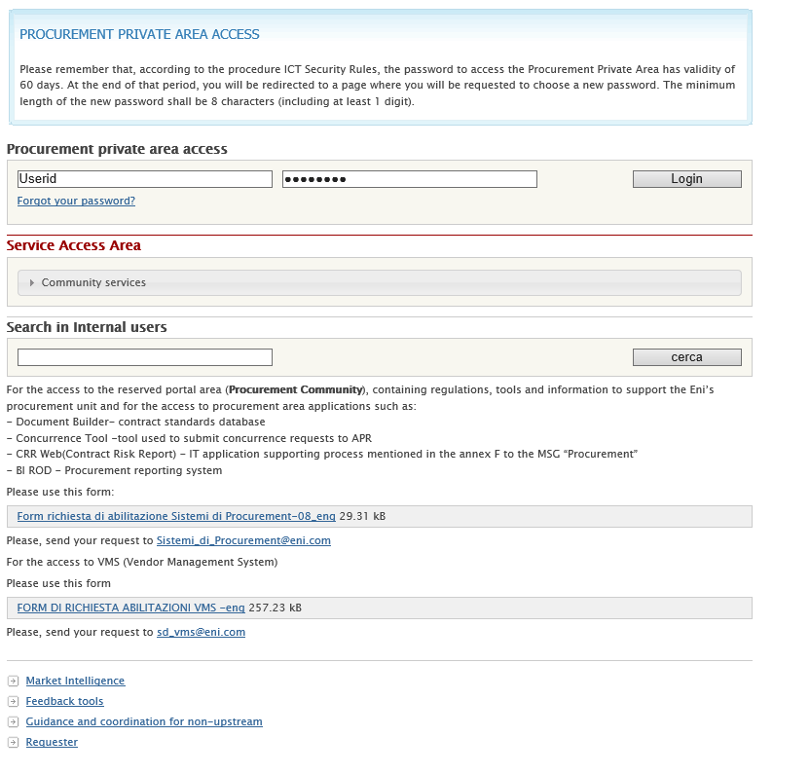
HOW CAN I REQUEST THE ACCESS TO VMS?
Send your request to
Mbx Sistemi di Procurement:
Sistemi_di_Procurement@eni.com

Slide 27
WHAT IS THE DIFFERENCE BETWEEN AN EXECUTION FB AND AN EVIDENCE?
Execution feedback
Objective:
allow the evaluation of the supplier's performance.
Evidence
Objective:
highlight critical elements related to the supplier, which could jeopardize the relationship with Eni, and activate the appropriate analyzes and feedback.

Slide 28
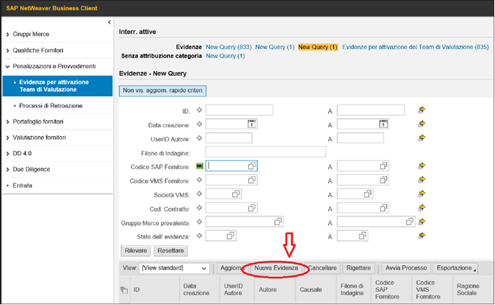
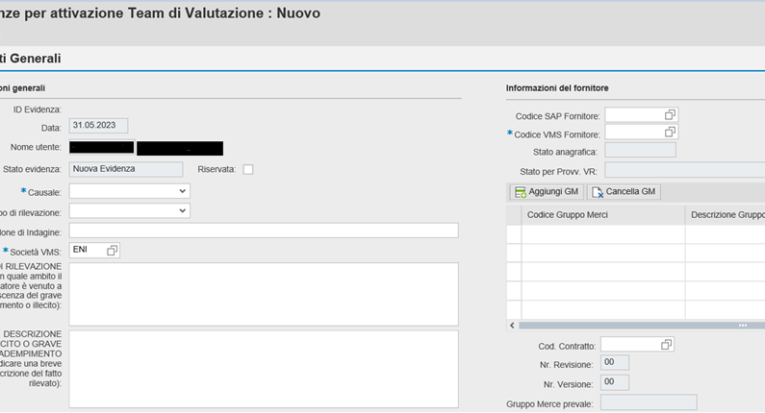
HOW AND WHEN TO OPEN EVIDENCE FOR A SEVERE MISPERFORMANCE?
If the non-fulfilment is such as to be considered "serious" (everything that involves actual damage of a significant entity from an economic or reputational point of view for the company, to be addressed beyond the normal contractual management, is deemed to be considered a serious non-fulfilment) it is necessary to open an evidence in VMS (section "Penalties and Provisions; Evidence for Activation of the Evaluation Team; New evidence")
STEP 1
The fields marked with an asterisk (*) must be filled in, providing a brief description in the dedicated fields.
STEP 2

Slide 29
HOW AND WHEN TO OPEN EVIDENCE FOR A SEVERE MISPERFORMANCE?
Finally, it is necessary to send an e-mail to the Mbx Comunicazioni Vendor Management Feedback box, in which all the details and supporting documents are provided, such as, by way of example and not limited to:
notice to fulfill and formal notification of the serious breach;
requests for penalties and any other dialogue initiated with the support of the relevant legal function, any response/justification from the supplier;
evidence of contractual termination;
any investigation report referring to NC HSE or action plan shared with the company.
It should be remembered that all the events that can be addressed through the contractual instrument and its management by the appointed functions (e.g. the application of contractual penalties) are attributable to the company's performance and the drafting of the execution feedback is sufficient.
STEP 3

Slide 30
WHO CAN GIVE ME SUPPORT IN THE EVENT OF PROBLEMS RELATED TO VMS FUNCTIONING?
Mbx SD VMS SD_VMS@eni.com
telephone contact 02.520.3010
Type of requests concerning the VMS system managed by SD team:
- system errors
- bugs to fix
- evolutionary activities or implementations which must however be requested from the Reference Client Manager
- punctual verification of authorizations with possible addressing to the correct method of requesting modifications or supplementary authorizations to operate the system correctly (the verification is the responsibility of the AM, the authorization request is not)
- general indications on the correct ways to operate on system processes. However, it is not possible to provide procedural indications or instructions on the processes and, in this case, the modus operandi provides for addressing the application referents or similar business figures.

